Slide 1
NATURAL LANGUAGE PROCESSING
-NIKHIL PATIL
Karmic embedded pvt. Ltd.

Slide 2
Content’s
INTRODUCTION
NEED OF NLP
PROCESS INVOLVED
APPLICATIONS
REFERENCES

Slide 3
INTRODUCTION
Natural language processing (NLP) is a subfield of computer science, information engineering, and artificial intelligence
It is concerned with the interactions between computers and human (natural) languages, in particular how to program computers to process and analyze large amounts of natural language data.

Slide 4
NEED OF NLP
Processing data at a faster rate.
Extracting meaningful information from the data.
Understand user's request in the form of free language.

Slide 5
PROCESS INVOLVED
TOKENIZATION
STEMMING
LEMMATIZATION
POS TAGS
NAMED ENTITY RECOGNITION
CHUNKING

Slide 6
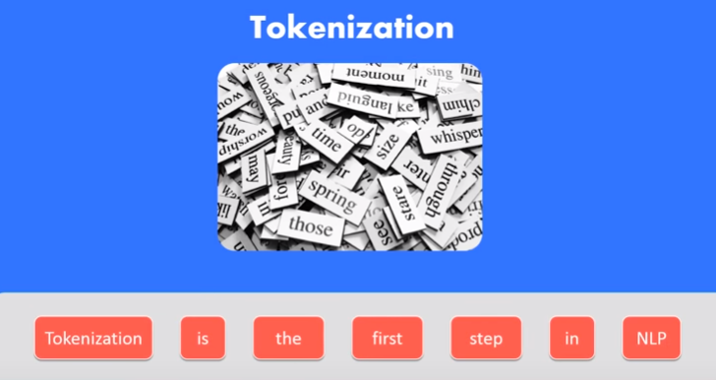

Slide 7
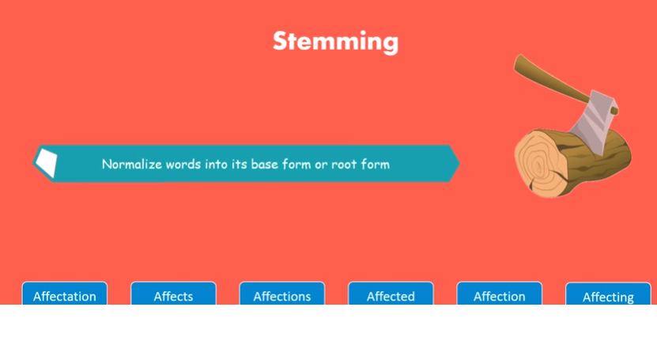

Slide 8
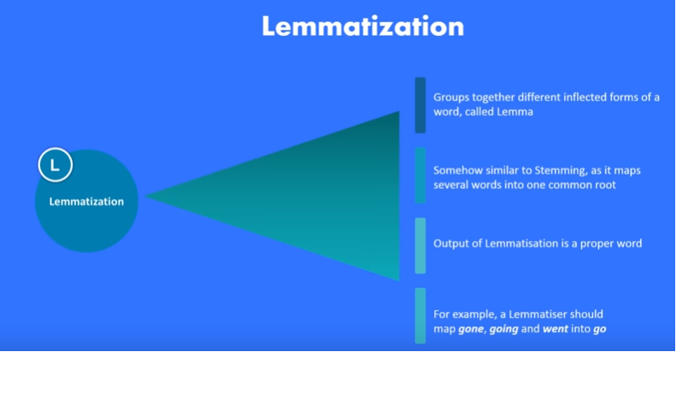

Slide 9


Slide 10
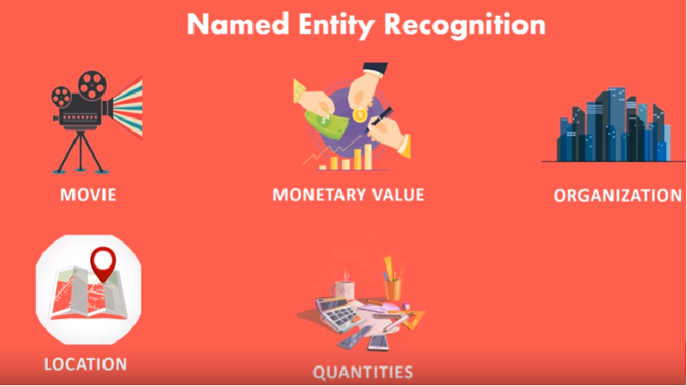

Slide 11
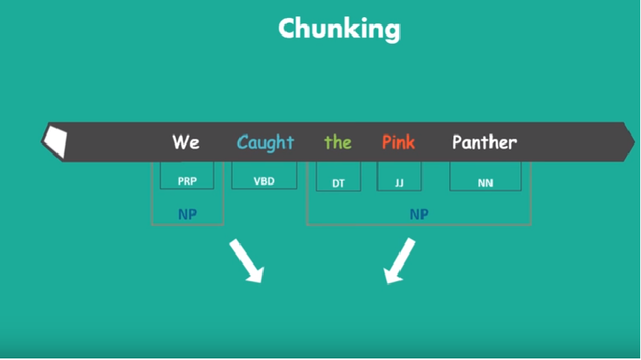

Slide 12
SO WHERE IS ALL THIS PROCESS DONE?
ITS IN PYTHON
A LIBRARY CALLED NLTK IN PYTHON IS USED FOR NATURAL LANGUAGE PROCESSING.

Slide 13
APPLICATION’S
CHAT BOT
MACHINE TRANSLATION
SPEECH RECOGNITION
SENTIMENTAL ANALYSIS
SPELL CHECK
INFORMATION EXTRACTION
ADVERTISEMENT MATCHING

Slide 14
REFERENCES
https://en.wikipedia.org/wiki/Natural_language_processing
Edureka

